Slide 1
FLIGHT MANAGEMENT SYSTEM

Slide 2
OBJECTIVE
The prime objective of "Flight Management System" is to develop a full fledged and hassle free environment available for both the client and the service provider.
Significantly reduce the use the count of multiple site visit.
Easy search for the flights and book tickets.
Easy addition and deletion of flights.
Make the overall interaction of user interactive and easy.

Slide 3
PROBLEM STATEMENT
There are always multiple site visits to get a ticket and thus it takes time to book a ticket.The efficiency of the site to find source and destination ticket is low.
And to provide the cheepest available fight journey to the user, there should be a user friendly platform to help the user.This project helps the user as well as the admin.

Slide 4
TECHNOLOGIES USED
JAVA,JDBC
SQL
HTML,CSS,JAVASCRIPT

Slide 5
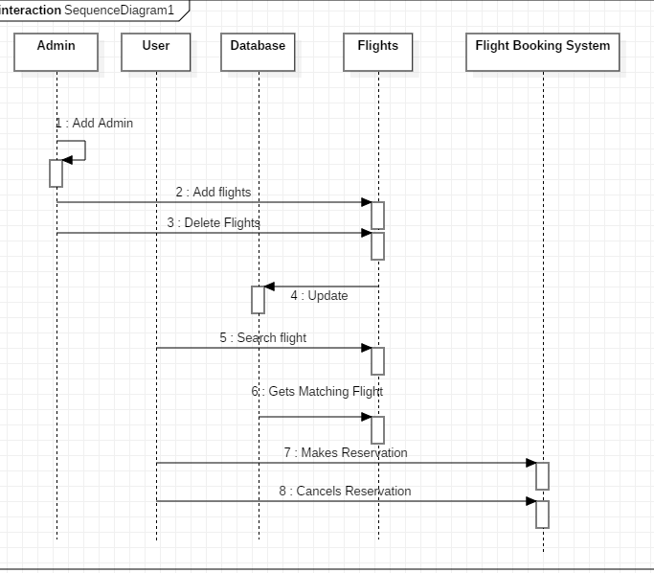
SEQUENCE DIAGRAM

Slide 6
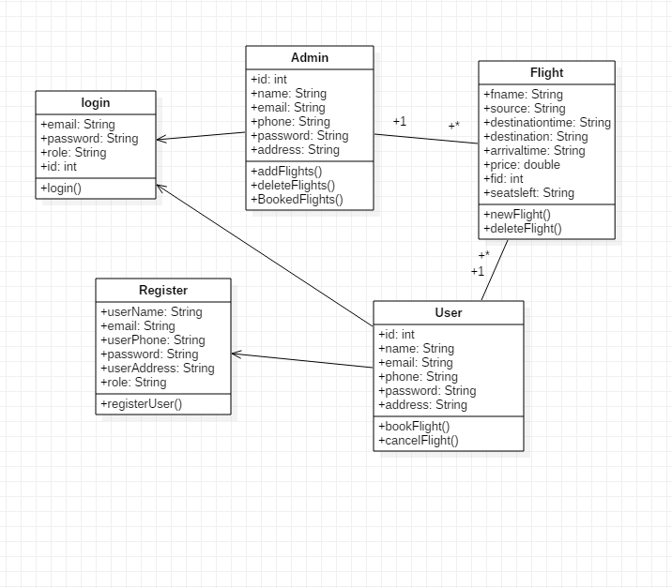
CLASS DIAGRAM

Slide 7
MODULES
There are basically three modules:
Admin module
User Module
Database Module

Slide 8
USER MODULE:
User can perform the following functions:
Register
Login
Search Flights
Book Seats
Cancel Flights

Slide 9
ADMIN MODULE
Admin can perform the following functions:
Add another admin
Add Flights
Delete Flights

Slide 10
DATABASE MODULE
It consists of three tables:
Login table – Allows to register new user and login registered user.
Flight table – Contains the information of flights.
Booking table- Stores the information of booked seats.

Slide 11
THANK YOU

